Slide 1
American Ninja Warrior
Most Popular Obstacles per Course Order
Google Cert Capstone Project - Kyle Marschall

Slide 2
Executive Summary
Television Executives for the hit TV show American Ninja Warrior want an analysis of what their most popular obstacles were in each order step of the course.
There were 10 total seasons of data
There are also 10 order steps in every course
There are numerous rounds and locations of every season, each having a different course layout

Slide 3
Case Study Information
In this case study, I was able to determine which obstacles were the most commonly used in each of the 10 steps of a course, from the data spanning over 10 seasons worth. There were also 225 unique obstacles used throughout the 10 seasons.

Slide 4
Cleaning The Data
I first cleaned the data using Google Sheets using conditional formatting and pivot tables to ensure all data was entered and accounted for, and was in a similar format.
I then created a master table which was imported into BigQueury where I used SQL to determine which obstacles showed up the most in each round, and sorted by round
After this, I exported the new table created in SQL to Google Sheets and was able to create my final dataset

Slide 5
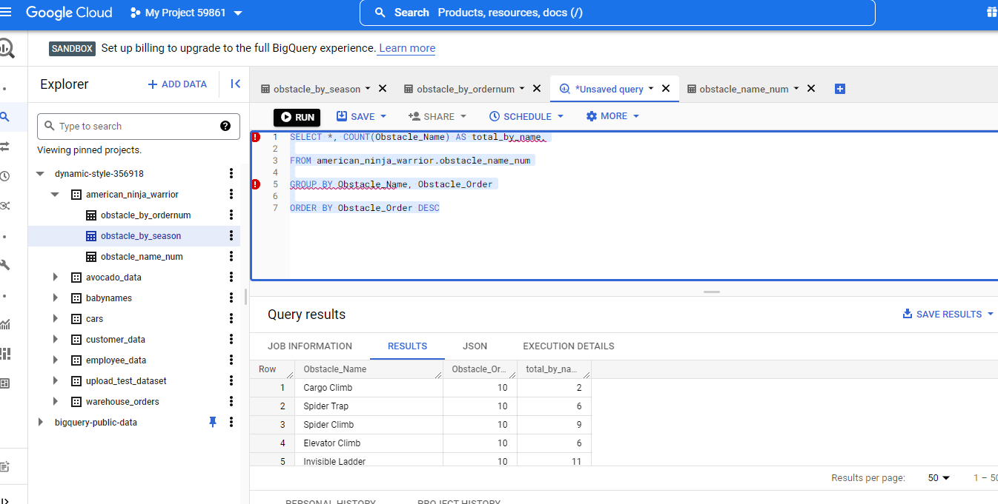
Cleaning the Data Using SQL

Slide 6
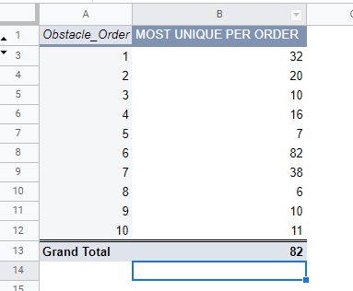
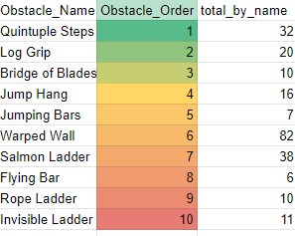
Confirmed my data using a pivot table to ensure the numbers match up on my final data table

Slide 7
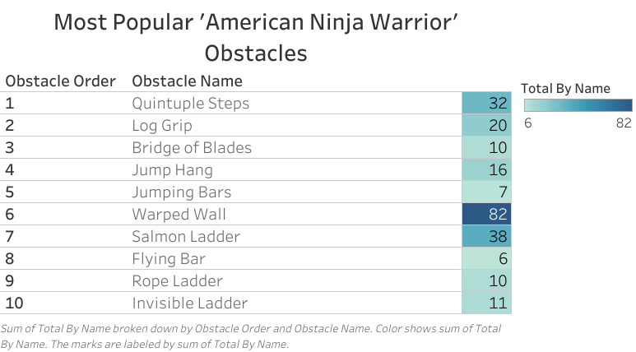

Slide 8
Conclusion
In conclusion, after analyzing the data from all 10 seasons of American Ninja Warrior, I was able to determine which obstacle was the most popular in each order of the course.
I also determined that the Warped Wall is the obstacle that showed up the most unique times, and the Flying Bar appeared the least unique times.
I have determined that this would be the most popular order in creating an optimal course based off of the most popular unique times each obstacle appeared at each specific order of the course.

